Slide 1

Introduction to the Windows 10 Universal Windows Platform
Kunal Chowdhury
Microsoft MVP (Windows Platform Development)
Windows 10 Champion | www.kunal-chowdhury.com
Twitter:
@kunal2383
Facebook:
@blog.kunal

Slide 2

The convergence journey
Xbox 360
Xbox One
Unified core and app platform
Converged
OS kernel
Windows 8.1
Windows 8
Converged
app model
Windows 10
Windows Phone 8.1
Windows Phone 8
Easy for users to get & stay current
Windows Phone 7.5
Windows on Devices
Notes:
Microsoft has been working to converge its client operating system and developer platforms for a long time.
In Windows Phone 7, the operating system was based on Windows CE which was the operating system for small, handheld devices, but different from the OS on ‘big’ Windows.
When Windows Phone 8 was launched, Microsoft swapped out Windows CE and based it on the Windows NT kernel. This was same on PCs and Xbox One.
But in Windows 8.1/Windows Phone 8.1 Microsoft delivered it on a converged developer platform. You can build universal 8.1 apps which shares a very high percentage of code and where you program against the same APIs.
With Windows 10, this has been improved even further and for the first time it allows developers to create a single app that can run across all devices running Windows 10. Windows 10 brings developers a unified core OS across all devices and a single app platform.

Slide 3

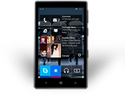
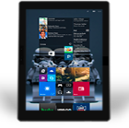
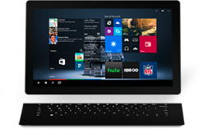
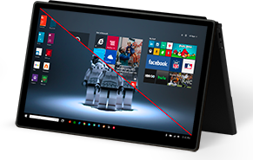
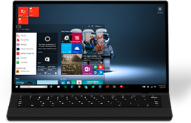
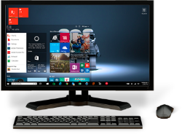
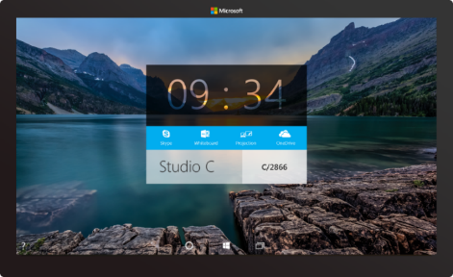

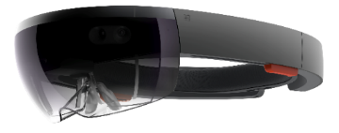



2-in-1s (Tablet or Laptop)
Classic Laptop
Desktops & All-in-Ones
Phone
Phablet
Small Tablet
Large Tablet
Windows 10
Surface Hub
Xbox
Holographic
IoT
Notes:
Windows 10 runs on a wide variety of devices, from phones with a 4.5” screen, through phablets, tablets, PCs, laptops, Surface, desktops and All-in-ones.
It also runs in Xbox in your living room and right up to giant 84” screens such as the Surface Hub.
And it also takes in very tiny cheap (IoT) computers such as the Raspberry Pi 2, and innovative hardwares such as Hololens.

Slide 4

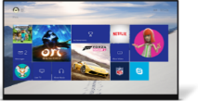
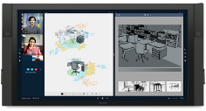

















PC
XBox
Mobile
Surface Hub
Devices +IoT
HoloLens
Universal Apps
Multiple device families
Adaptive User Interface
Reuse Existing Code
Natural User Inputs
One Store + One Dev Center
One SDK + Tooling
One Universal Windows Platform
Notes:
Microsoft has divided this broad range of hardware into different device families – as developers you will likely build apps that target one or more device families.
We have small devices and IoT, phones and small tablets in the Mobile device family, large tablets and PCs in the PC (or as we more usually call it, Desktop) family, the Xbox, Surface Hub and finally the Hololens.
And all of these device families run the same developer platform – the Universal Windows Platform. You can build a single app that can run across all these device families using a single SDK and distribute apps through a single store.
Of course, with this diversity of devices, what we are *not* saying is that you should create one app that kind of works adequately across all these devices. No, we want you to create apps that shine on each device family, so there are new added APIs, controls and tools to help you build an adaptive UI.

Slide 5
WPF
WF
MFC
XAML
HTML
Bridging technologies
Obj.C
iOS
Java
Android
Web
hosted
Win32
desktop
DirectX
.Net
languages
C++
.Net
languages
C++
& CX
WWA
.Net
runtime
Universal Windows Platform
Windows 10
operating system
Notes:
So let’s take a look at the different ways you can build apps for Windows 10.
First of all there are the ‘traditional’ ways of building apps for Windows desktop, using tools such as WPF, MFC and full .NET. These are what we term ‘CWA’ (Classic Windows Apps) and are still a great way of building apps for Windows desktop. Although, note that there is tool from Microsoft, that will allow CWAs to be packaged for distribution through the Windows Store.
Then, we’ve got the new UWP, which is based on the Windows Runtime APIs that we used for building Windows Store apps in Windows 8.x and Windows Phone 8.1. Here you can use HTML and JavaScript to create universal Windows apps, or XAML and C#/VB or C++, or you can use DirectX and one of the many popular middleware packages to create games. And these all build upon the UWP APIs and can run across all Windows 10 devices.
Finally, we’ve got a number of bridging technologies. This is to enable developers to use whichever technologies they are comfortable with, and help them to create Windows apps. So we’ve got the Windows Bridge for iOS, the Windows Bridge for Android, hosted Web Apps to help web sites to be discoverable through the Windows Store and to call UWP APIs, and a Bridge for classical Windows Apps.

Slide 6
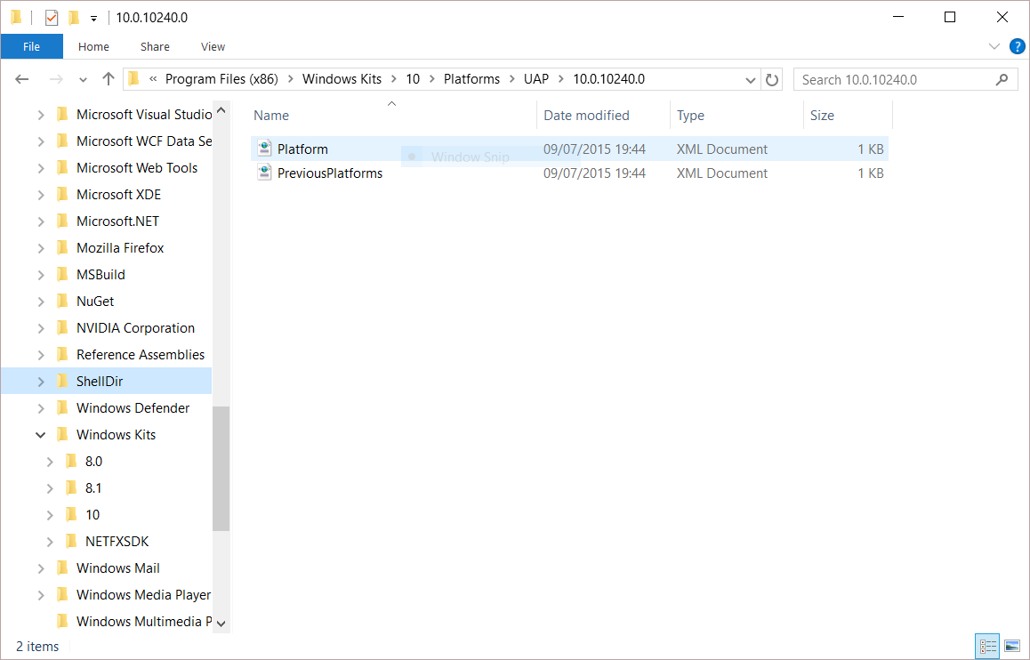
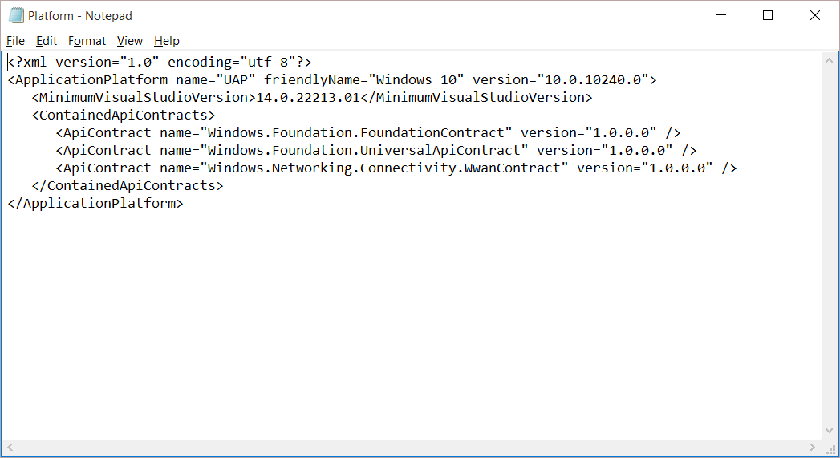
Universal Windows Platform
A single API surface
A guaranteed API surface
The same on all devices
Universal Windows Platform
Windows Core
Desktop
Device
Phone
Device
Xbox
Device
Notes:
So, what is the Universal Windows Platform?
It’s a single API surface that is consistent across all Windows 10 devices.
This guaranteed API surface is what enables developers to build a single app that can run across all devices.
What we’ve done is taken the Windows Runtime APIs that we first launched with Windows 8, massively expanded it and we’ve also componentized it, dividing it into a number of ‘contracts’.
Why ‘contract’? – Because these components provide a contract between the platform and you, the developer, that a certain major version of a contract will offer a guaranteed API surface and behaviors, even through many minor revisions. It allows us to innovate and enhance the platform by releasing updated components exposing new capabilities and allows you to develop apps against a versioned API.

Slide 7
Universal Windows Platform
Mobile
Desktop
Unified Developer Platform
Single Application Package
Adaptive Code
Universal Windows Platform
Core APIs
IoT
Xbox
Holographic
Surface Hub

Slide 8
A whole lot of APIs…
Storage
DirectX 12
Speech and Cortana
Networking
NFC and Bluetooth
Holographic
Audio and Video
Appointments/Calendar
Authentication Broker
Background Transfer
Maps and Location
Sensors: Accelerometer, light, magnet …
Tiles and Notifications
App to App and App Services
Inking
XAML
Background Tasks
Data Roaming
Data.XML
Media Casting
Many, many more….
Notes:
And it’s a big API!
Here’s just a sample of some of the feature areas that UWP APIs cover.
As you build apps against the UWP, you will find that the vast majority of the things you want to enable can be achieved by APIs that are in the UWP – and therefore available across all Windows 10 devices. We do have a way of calling device family-specific APIs, and we’ll come onto that shortly. But most of what you need can be found in the UWP.

Slide 9
Apps don't target Windows 10, apps target the UWP
Notes:
And this is a subtle change in your thinking as an app developer: you’re not building apps against an OS – Windows 10 – you’re building apps against the Universal Windows Platform, which is serviced and is updated independently of the OS.

Slide 10
<Dependencies>
<TargetDeviceFamily
Name="Windows.Universal"
MinVersion="10.0.10240.0"
MaxVersionTested="10.0. .0"/>
</Dependencies>
14393
10240
Notes:
In your application’s Package Manifest, you will have a declaration such as this.
What this says is that this app was built against UWP version 10.0.10240.0. When you create your first UWP apps, the MaxVersionTested will also be set to 10.0.10240.0, but imagine a time in the future, when newer versions of the UWP have been released to install side by side with earlier versions.
If you the developer have tested this app on UWP version 10.0.14393.0, you can declare this in the manifest. What this then says is that this app package will run just great on 10.0.14393.0. It doesn’t mean it cannot run on later versions, just that if it does, then the runtime should enforce version 10.0.14393.0 behaviors.
The Windows Store uses this information to ensure the best available version of an app package gets deployed to target machines.

Slide 11
The Universal Windows Platform can update at its own cadence
Notes:
The old days of 3 year OS engineering cycles, at the end of which we release a big new version of Windows, or a major Service Pack – those days are gone. Instead, Windows 10 is more of OS platform that is ‘Windows as a Service’ – a continuously serviced, continuously improved, continuously enhanced operating system.
And the UWP is the guaranteed API surface that you build apps against. It too is continuously enhanced and new versions will be released at regular intervals, but it has its own update cadence that is independent of the OS.

Slide 12
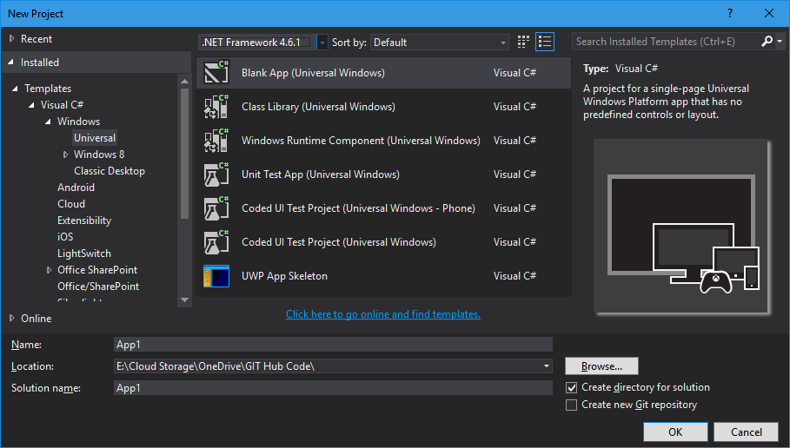
Windows app
A single binary
Running on any device
Testing for capabilities
Adjusting to devices
Windows App
Universal Windows Platform
Windows Core
Desktop
Device
Phone
Device
Xbox
Device
Notes:
So, on top of the UWP, you build your universal Windows app.
Unlike in Windows 8.1, where a universal 8.1 app creates separate binaries for PC and for Phone, with UWP it truly is a single app package that can run on any UWP device.
The runtime on each device family is able to run UWP apps whatever the device.

Slide 13
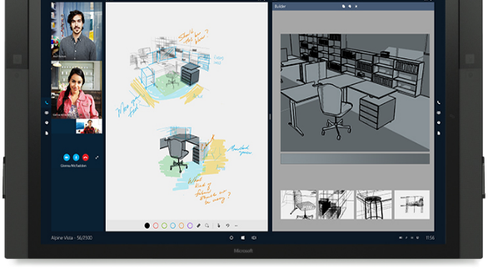
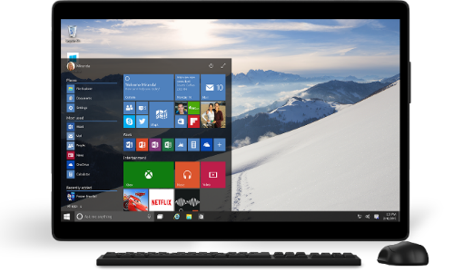
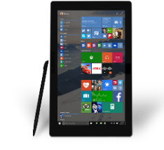
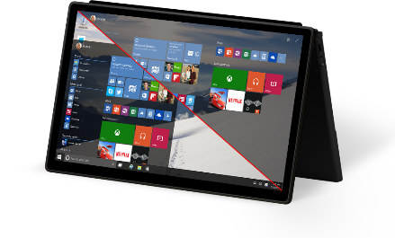
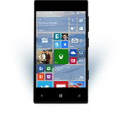

Universal Windows Platform
One Operating System
One Windows core for all devices
One App Platform
Apps run across every family
One Dev Center
Single submission flow and dashboard
One Store
Global reach, local monetization Consumers, Business & Education
Notes:
Windows 10 offers an unprecedented opportunity for developers: the same core operating system across all Windows 10 devices, a common app platform, a single dev center where the developer can manage their app submissions for all Windows 10 devices, and a single Windows Store for app deployment, including special access for Businesses and Education.

Slide 14
One Windows
Desktop SKU
Mobile SKU
Xbox SKU
IoT SKU
IoT headless SKU
Surface Hub SKU
Holographic SKU
PC
2 in 1
Tablet
Phablet
Phone
Xbox
Band
Raspberry Pi
Surface Hub
HoloLens
Home Automation
Notes:
Let’s take a look again at the device families. As we said before, we are dividing Windows 10 into broad groupings of similar devices, called device families.
And while all these device families offer a distinctive user experience to the end user, they all run the same app platform so you can create apps that run across a broad range of these device families.
This commonality is a strength – but what we are *not* saying is that you have to create some kind of ‘lowest common denominator’ app that works adequately across devices. We want you to create apps that shine on each device and offer the best possible user experience to end-users of your app.

Slide 15
Each family offers its own shell and adds features to those it inherits
Notes:
If you think about the primary user interface of each device family – the Windows shell – each device family offers its own user experience that is appropriate for that device. Each device family also has its own distinctive features that create a great user experience for users of that device. There are also a small number of APIs specific to each device family that you can call to create differentiating experiences on each device – we’ll come onto that in a short while.

Slide 16
Adaptive code
Notes:
Adapting the UI to different screens is the major part of creating an app that works across different device families, but you may also want to call device family-specific APIs to create unique experiences on different devices.
You can do this using something we call ‘Adaptive code’.

Slide 17
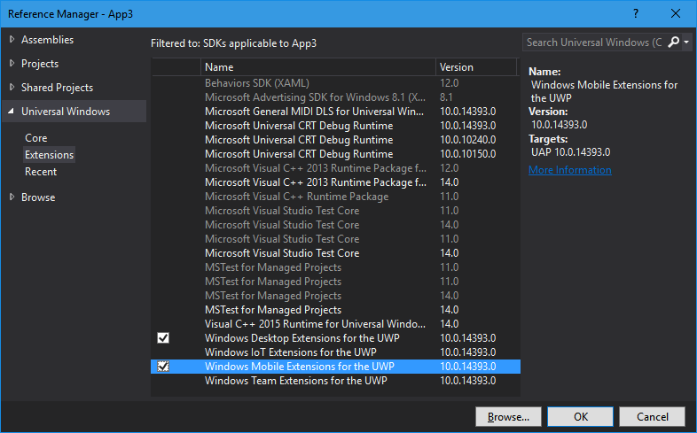
Platform extensions
Device-specific API
Family-specific capabilities
Compatible across devices
Unique update cadence
Windows App
Desktop
extension
Phone
extension
Xbox
extension
Universal Windows Platform
Windows Core
Desktop
Device
Phone
Device
Xbox
Device
Notes:
Although the majority of the APIs you need for a UWP app are in the common API set, we also make available device family-specific APIs. We release these as Platform Extension SDKs. You can add a reference to these extension SDKsin exactly the same way as any other reference library.
Like the UWP itself, these extension SDKs are versioned and may be released and updated independently of the UWP and the OS.

Slide 18
Platform extensions don't invalidate binaries on other devices
Notes:
The most important thing to realize about extension SDKs is that when you reference the extension SDK for a particular device family, you are not limiting the app to now be able to run only on that device family. When you package the app and distribute it, it can still run across a broad range of device families.
There are ways of limiting distribution of your app during the app submission process to the Store, but adding a reference to an extension SDK is not a part of that process.

Slide 19
UWP
UWP
UWP
UWP
Windows Core
Windows Core
Windows Core
Windows Core
Desktop
Mobile
Xbox
More…
Notes:
This diagram illustrates how it works:
<Click> Each device family runs the same core OS
<Click> Your app is built upon the UWP and that is common across all device families.
<Click> When you add a reference to an extension SDK, you are making those APIs available to be called by your application code – but those APIs are only usable at runtime on the matching device family
<Click> Although, when you add a reference to an extension SDK, the metadata for those APIs are loaded into your project, so the C# compiler and Visual Studio Intellisense works correctly when you reference those APIs during the app development process.

Slide 20
Test capabilities at runtime
Use Adaptive Code to light-up our app with capabilities on specific device families
Testing for capabilities and namespaces
var api = "Windows.Phone.UI.Input.HardwareButtons";
if (Windows.Foundation.Metadata.ApiInformation.IsTypePresent(api))
{
Windows.Phone.UI.Input.HardwareButtons.CameraPressed += CameraButtonPressed;
}
Notes:
So, we’ve got these device family-specific APIs that your app code can use, but they are only usable at runtime on specific device families. How do we make sure these APIs are called only at the appropriate time?
The answer is to ‘gate’ calls to any API in an extension SDK with runtime checks to verify that a particular API is available to use. You do this using methods of the Windows.Foundation.Metadata.ApiInformation API. The most common method to use is IsTypePresent() which is a runtime check that the named API is actually loaded and usable wherever the app happens to be running.

Slide 21
Development tools

Slide 22
Visual Studio 2015 Editions
Enterprise Edition
- an Enterprise grade solution with advanced capabilities for teams of any size or complexity
Professional Edition
- tools and services for individual developers or small teams
Community Edition
- a free, full-featured and extensible tool for developers building non-enterprise applications
Notes:
Visual Studio 2015 comes in a number of editions that serve the needs of different groups of developers.
Visual Studio Enterprise with MSDN is an Enterprise grade solution with advanced capabilities for teams working on projects of any size or complexity, including advanced testing and DevOps.
Visual Studio Professional with MSDN offers professional developer tools and services for individual developers or small teams.
Visual Studio Community is a free, full-featured and extensible tool for developers building non-enterprise applications.

Slide 23
Universal Windows App Development Tools
Download Now !!!
Visual Studio 2015 Update 3 with
Install latest Windows 10 OS (10.0.14393.x)
windows.com
Install VS 2015 Update 3 w/ Universal Windows SDK & Tools
www.visualstudio.com
Build your first Universal Windows App
downloads.kunal-chowdhury.com

Slide 24
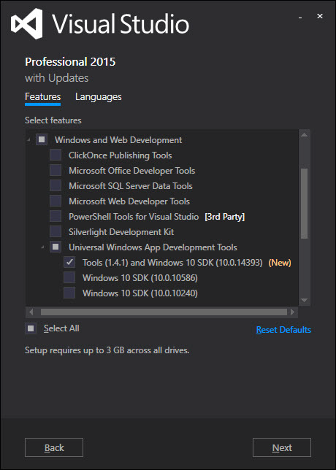
Acquiring Windows 10 Tools/SDKs/Emulators
Select “Universal Windows App Development Tools” using Custom setup option

Slide 25
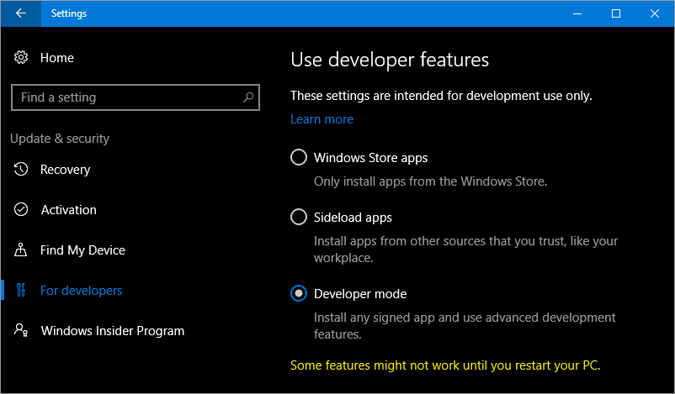
Developer unlock
Notes:
There is a different approach for development for Windows 10 devices. A developer license is no longer required for each device that you want to use to develop, install or test your app. You just enable a device once for these tasks from the settings for the device. That's it. No more renewing your developer licenses every 30 or 90 days!
You can easily developer unlock any Windows 10 PC/laptop/tablet or Phone just by going to System Settings to allow you to deploy apps to the device directly from Visual Studio and carry out on-device debugging and testing, or just for sideloading apps that have not been certified by the Windows Store.

Slide 26
Project Templates

Slide 27
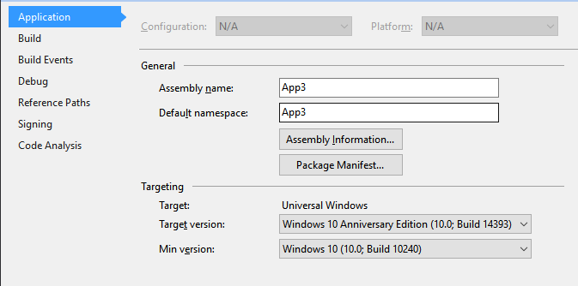
Project Properties
Target version (TargetPlatformVersion)
Defines the version of Universal Windows SDK being targeted by project
Defines the available API surface for the application
Is stamped as TargetDeviceFamily.MaxVersionTested property in the AppX manifest file as part of the build process
<Dependencies>
<TargetDeviceFamily
Name="Windows.Universal" MinVersion="10.0.10240.0" MaxVersionTested="10.0.14393.0" />
</Dependencies>

Slide 28
Project Properties
Min version (TargetPlatformMinVersion)
Defines the minimum version of Universal Windows platform being supported by the project (adaptive application package)
Is stamped as TargetDeviceFamily.MinVersion property in the AppX manifest as part of the build process
<Dependencies>
<TargetDeviceFamily
Name="Windows.Universal" MinVersion="10.0.10240.0" MaxVersionTested="10.0.14393.0" />
</Dependencies>

Slide 29
App Insights
App Insights enable developers to monitor app’s performance and usage statistics
Universal Windows project templates are enabled for App Insights and monitors app users, sessions, page view, crashes and real time usage without writing any additional code
Developers can easily add custom events to collect additional telemetry data for the app

Slide 30
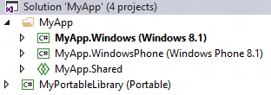
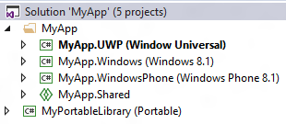
Universal 8.1 App
Upgrade Windows/Windows Phone 8.1 projects
Add single Universal Windows project to target different Windows 10 devices
Use Adaptive code for device family specific APIs
Use Adaptive UI to support different form factors
Use Shared projects, WinRT components, PCLs to share code between Universal Windows, Windows 8.1 and WP 8.1 projects
1: Single Universal Windows Project

Slide 31
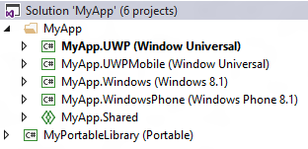
Universal 8.1 App
Add a new Universal Windows project to target a specific Windows 10 device (ex: Mobile)
Update Package.appxmanifest to include “Windows.Mobile” device family with matching MinVersion/MaxVersionTested
<Dependencies>
<TargetDeviceFamily
Name="Windows.Mobile"
MinVersion=“<Windows.Mobile MinVersion>“
MaxVersionTested=“<Windows.Mobile MaxVersionTested>"/>
</Dependencies>
Add a new Universal Windows project to target other Windows 10 devices
Use Shared projects, WinRT components, PCLs to share code between Universal Windows, Windows 8.1 and WP 8.1 projects
2: Different project/package for a device family

Slide 32

Questions
Kunal Chowdhury
Microsoft MVP (Windows Platform Development)
webmaster@kunal-chowdhury.com
www.kunal-chowdhury.com
@kunal2383

Slide 33

Th
Thank you
12:38

